Slide 1
DEVELOP AN OUTCOME L2
Evidence of Learning Template
0158049920
Project Title
Snake Game

Slide 2
Github /Drive link
https://drive.google.com/file/d/1WfaHaGXKrFvZsy4XEC9qK8fQTFlubUS0/view?usp=sharing
Trello board or PM link
https://trello.com/b/lUaXVqmw
You MUST provide evidence showing how the problem has been decomposed, how the components have been developed and trialled, and of how they have been assembled and tested to create a final, working outcome.

Slide 3
Planning
Initially, I had two projects in mind, and they are snake game and quiz. I decided to choose snake game as my project over quiz because, I believe that a snake game is more interactive compared to a quiz. For example if we finished a quiz once, there wouldn't be any fun in attempting it again , but this is not the same in the case of a snake game because you would always want to replay the game in order to beat your previous score.Another reason why i decided to make a snake game is due to the current situation in the world, as we know most parts of the world are in lockdown, so the snake game would keep kids engaged and entertained.The time targets I had to finish this project is about 8 weeks, this allowed me to break my project into several components and allocate a certain amount of time to work on each component. These components include Windows, Snake and Apple and Game functions. To give me an estimation on how long I had to spend on each component of code, i have created a bar graph.

Slide 4
Project management: Setup
Record evidence that you have setup project management tools to manage the development of your outcome.
Record evidence that you have chosen project management techniques to manage the development of your outcome.
Record evidence that you have setup/ chosen version control tools/techniques to manage the development of your outcome.
Explain why you believe that these tools and techniques are appropriate for the development of your outcome.

Slide 5
Project management tools
 | Positives | Negatives | Interesting
Trello | User friendly Easy to organize Suitable for smaller projects. Convenient for individual projects. And it's compatible with other devices such as ipad, phone. | Does Not work without internet. Limited storage(10 mb per upload) | Commands to archive, or email a report every week. We can add checklists or deadlines.
monday.com | Color coded customizable tags. The ability to have multiple views including bar and pie charts. Time tracking on each task | Complex, and not straight forward. Not suitable for smaller projects Interface is slow and buggy. | Monday lets you automate recurring tasks.

Slide 6
Project management
Initially I struggled to choose between two project management tools:
Trello
monday.com
But I decided to use Trello board because the project I am doing is an individual project and I felt like monday.com is a program that is used to manage a team and to work on a team project. And it was complex for me to manage my tasks. As i didn't have enough time to learn about monday.com, so i decided to use Trello because its easy and efficient to use.Another reason why i decided to use Trello Is because it allows us to easily move cards from one list to another list, This is really helpful because if I have any unfinished tasks in a given time i could simply move them to next list.

Slide 7
Project management
One of the reasons why I chose Trello to manage my outcome is because it provides us with a wide range of techniques and commands to manage our work efficiently. Some of the techniques that i used to manage my work are:
I divided my work over the time period of 8 weeks,and created a list for each week. In these lists I added cards which consists of tasks that I wish to complete in a particular week.Another feature that I made use of are checklists that could be attached to a list, this feature allowed me to create checklists that consists of tasks to be finished in a given week. As i finished a task I proceeded to tick the box related to the task in the checklist.This made it easy for me to keep track of the tasks that I have finished in a given week.
Another feature I used to manage my project are due dates, this is a key feature as it acted as a reminder for me at the end of every week, i made use of this feature and set a due on all the tasks assigned in a given week.
Another cool feature that i made use of in trello are the automated commands. These commands basically allow you make your own common to perform an action automatically this includes moving a card from one list to another, adding a label to cards and etc..
I made use of the automated command to make a command which moves all the overdue cards in a list to a new list which is named overdue and label these cards red.
Trello also provides us with a command which emails a report of all the overdue cards at the end of every week,This really helps me because if I get caught up with some other work on a given week, this email reminds of all the tasks i need to complete on a friday night. So, this means that I can make use of the weekend to finish the overdue tasks.

Slide 8
Project management
Another feature that i made use of is the button command that trello provides, so this basically allows us to create a button to perform an action. I made use of this feature to create a button called “Done”, which moves a card to a list called “work done”, when pressed.This allows me to keep track of all the work that I have finished and all the work that I need to finish.
I used the activity log provided by the trello board to control all the activity and versions, I have also made some copies of the board when i was testing with new commands as i didn't want to lose my work.
These tools and techniques are appropriate for the development of my project as my project being a big project it is really easy to lose track of the work I did or the work i need to do. The tools and techniques provided by trello helped me to plan and keep track of my progress at a given time.I believe that if it wasn't for the tools reminding me of the tasks that I need to finish each week I wouldn't have been able to design my outcome as I planned to at the beginning. Another benefit of using these techniques is that i can spread my workload evenly and i don't need to work on the whole project in a day or two.The weekly reminder email also helped me as it informed me of all the unfinished work i had on a friday night, so this would give me the weekend to finish this work. Hence why I've always set due dates to friday night.

Slide 9
Project management: Applied
Record evidence that you have used your project management tools to manage the development of your outcome.
Record evidence that you have used your project management techniques to manage the development of your outcome.
Record evidence that you have used version control tools to manage the development of your outcome.

Slide 10
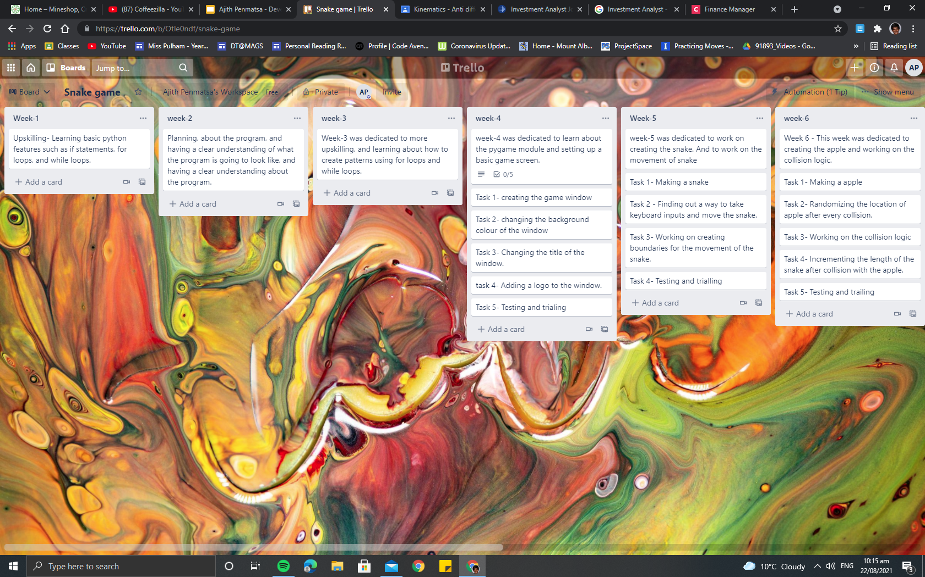
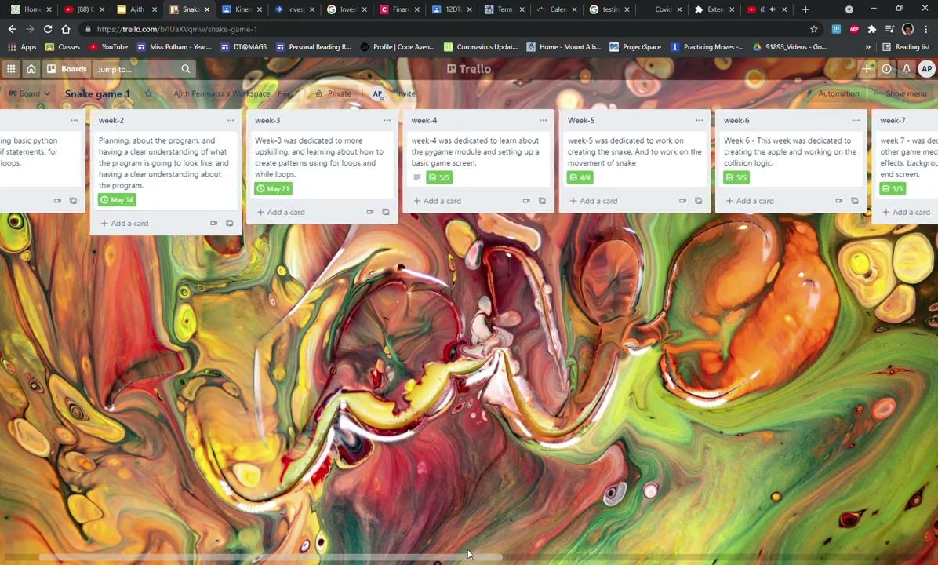
Project management: Appplied
Board during the beginning of the project.
Board during the end of the project

Slide 11
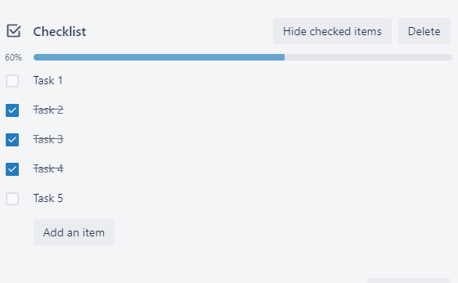
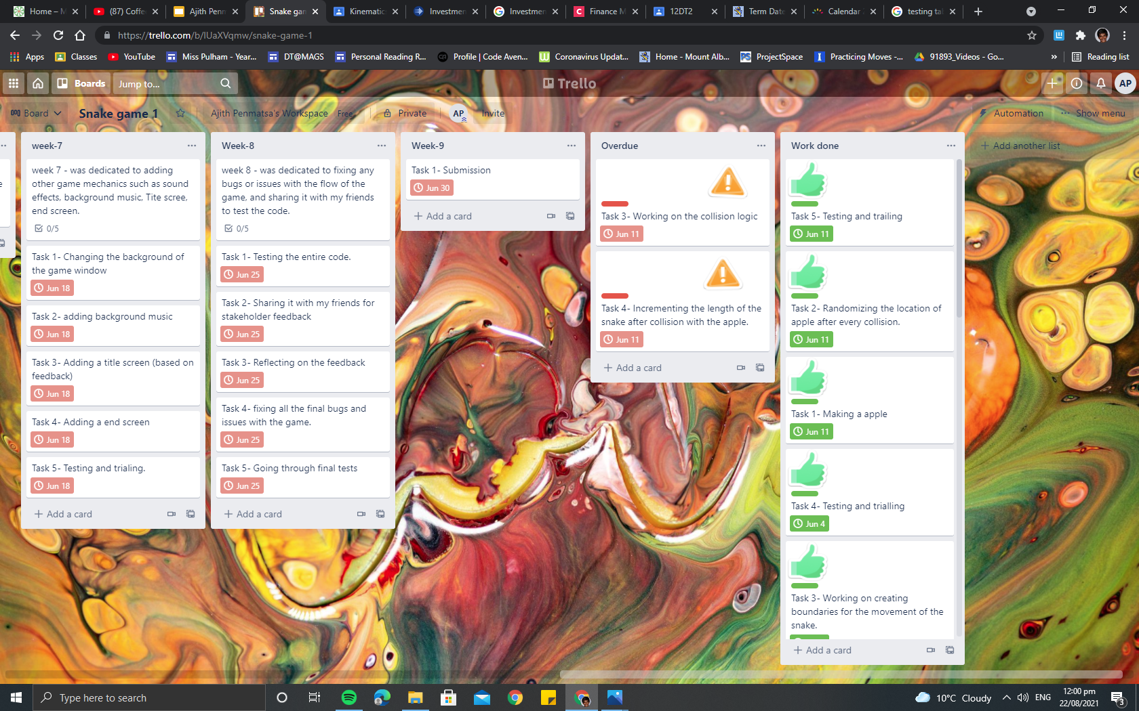
Project management: Appplied (Techniques)
As you can see you can simply tick a box after finishing the task, this helped me keep track of the work that i have finished in a given week.
This is how i made use of the Automated commands feature, as you can see the cards that are overdue will automatically move to a new list called overdue, and they are labelled red with danger sticker on the card

Slide 12
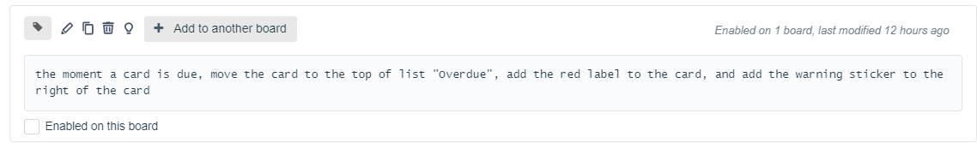
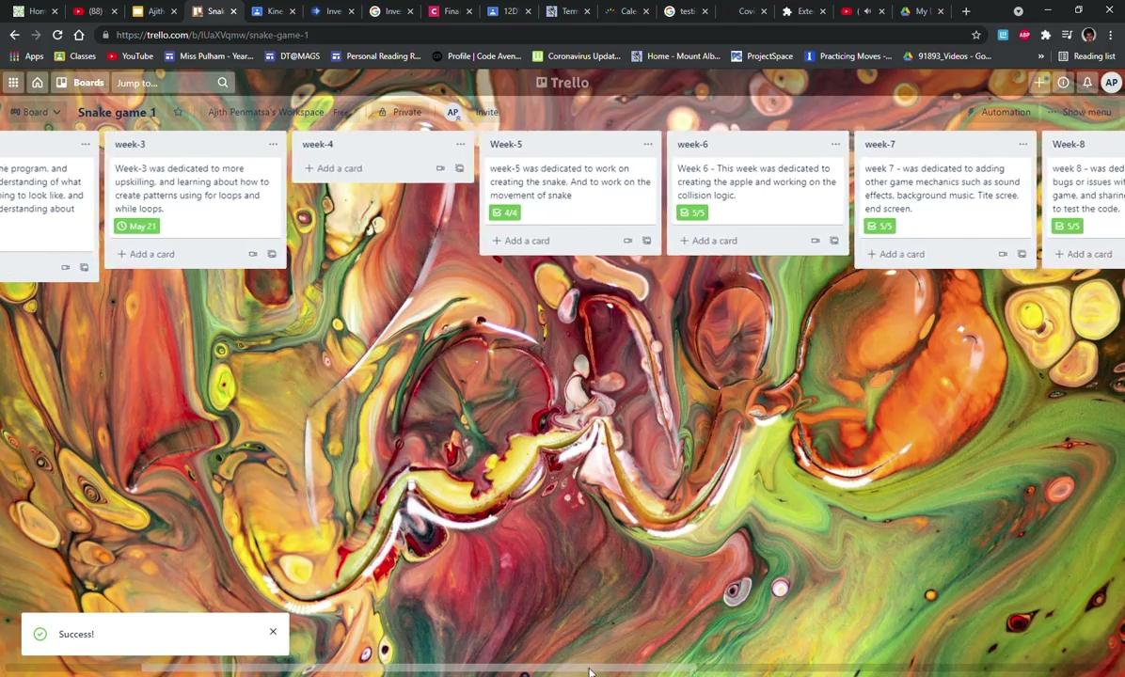
Project management: Applied (Techniques)
This is the automated command that I used.
This is how the done button works

Slide 13
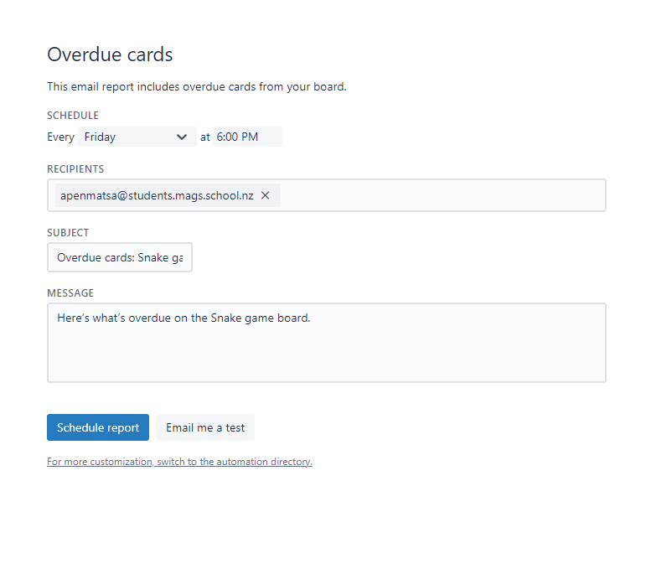
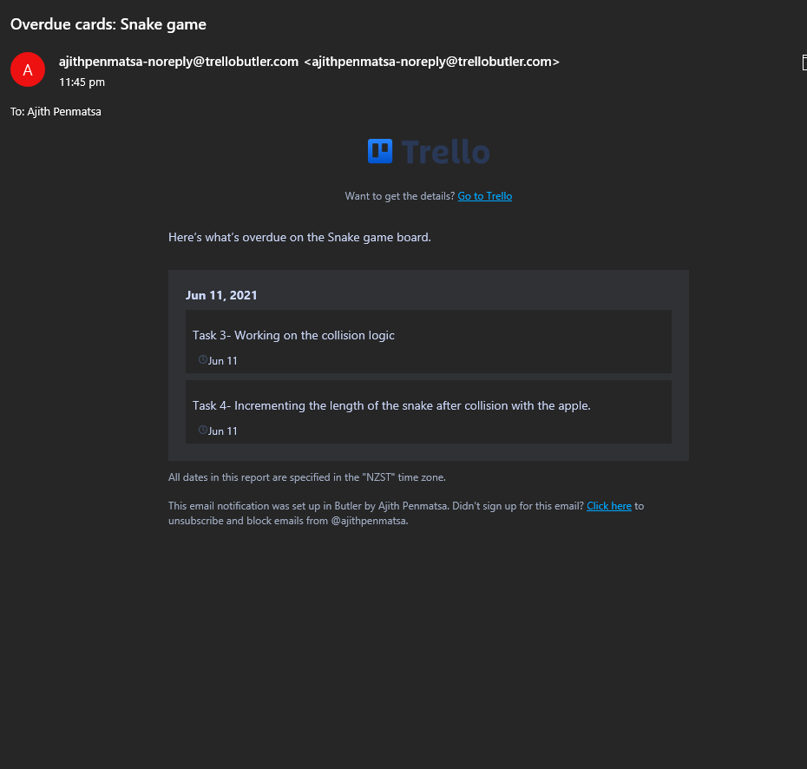
Project management: Applied (Techniques)
This is the command I used for email report
This is the email report i have received from trello

Slide 14
Agile methodologies
What is agile development?
Agile development is the process of development where we follow an iterative with delivering components one by one rather than delivering all at once at the end.This helps in improvements, which leads to a higher quality of work. I personally used project board methodology to manage my digital outcome. This methodology includes dividing the project into three parts, “To do”, “working”, “done”. I used Trello board to follow this methodology, using trello board i have divided my entire project into 8 weeks. This means i have created 8 lists (each dedicated to a respective week) and each lists consists of cards which describes the tasks, this acts as the “To do”. I have set due dates so that i work on a list of tasks each week, this acts as the “working”. After i finished working on a task I press on a button called “done”, this button moves the card to a new list called “work done”. So, therefore by the end of the project I would have all the cards under the “work done” list.

Slide 15
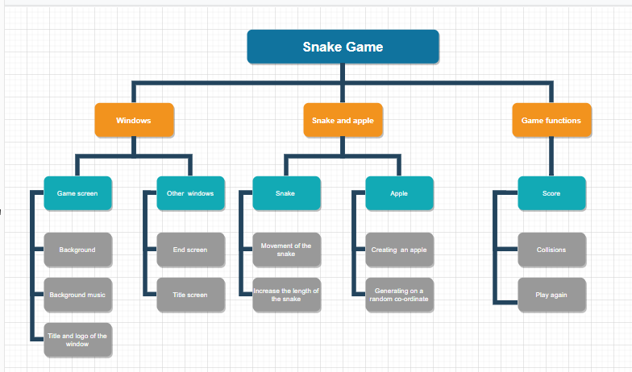
Decomposing Outcome

Slide 16
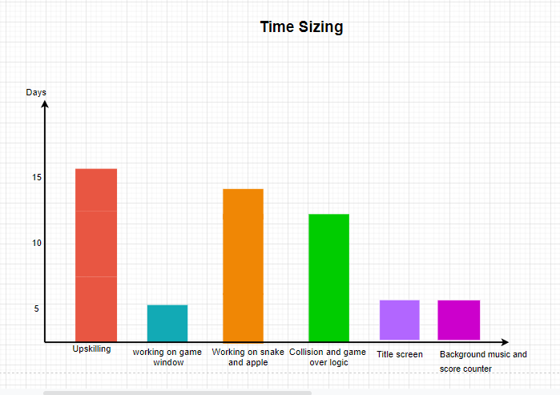
Estimated time sizing graph
I divided my snakee game into 3 main components.

Slide 17
Decomposing Outcome
I divided my project into three main components:
Windows
Snake
Game functions
Windows component- Windows component consists of the game window,title screen and end screen.
Title screen- The title screen acts as an introduction to the game, and displays the instructions on how to play the game.
Game window- This is the window is where the game is actually being played.
End screen- This window displays the text “Game Over”, and asks the end user if they would like to play again.

Slide 18
Decomposing Outcome
Snake and apple :The snake and apple component is further divided into smaller components, they are:
Movement of snake- This component involves accepting commands from the user and moving the snake accordingly.
Increment of snakes length- This component involves incrementing the length of the snake, whenever it collides with an apple.
Randomization of apple- This component involves, spawning the apple in another random location after it collides with the snake.

Slide 19
Decomposing outcome
Game: Game component consists of all the components required for the game to run, they include:
Collision- This component covers all the functions of the game that involves collision, like eg. snake colliding with the apple and the snake colliding with itself.
Score recording- This component covers the idea of recording score, when the snake collides with an apple.
Play again- This component involves the idea of playing again, when te game ends

Slide 20
Trialling components
Record evidence that you have trialled components. Show that you gathered information to inform your decision making.
Record evidence that you have trialled multiple components and have selected those most suitable.
Record evidence that you have used information from trialling appropriately to improve the functionality of the outcome.

Slide 21
Comparing alternatives
As you can see, when i tried to run the code it just shows a black screen, whereas in pycharm it actually loads the game. Therefore i have made a decision to use pycharm to further develop my game. Pycharm also comes with its own advantages, such as version control and suggestion to fix any errors, so therefore I have found pycharm much more comfortable to use.

Slide 22
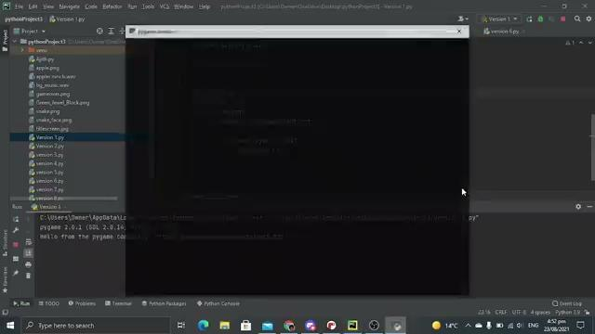
Trailing Components
Pycharm vs MU editor
Initially we have done our upskilling using MU editor, but I had to switch to pycharm as MU editor could not run pygame, and the interface was really slow.

Slide 23
Trailing components
Normal structuring vs OOP (Object oriented programing) structure
I initially started coding the project in a normal structure using functions. As i progressed i decided to use OOP structure to code my game. I made this decision because I felt that this would give me any opportunity to further upgrade or improve my code with ease. Another advantage of OOP is that the code is really organized, for example if i had an issue with the snake, i can simply go to the snake class to find and fix the issue, rather than scrolling through a pile of functions. And i also believe that this made my code more robust and user friendly.

Slide 24
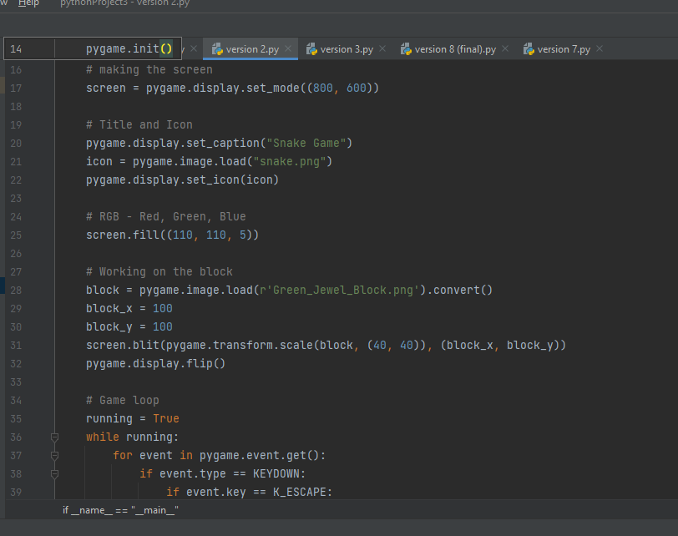
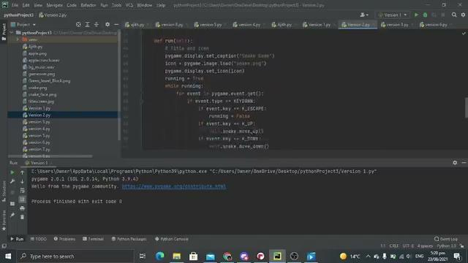
Trailing components
As you can clearly see, OOP formatting is way more organized, whereas the other format just looks like random blocks of code. This also correlates with the implication of future-proofing, as there is more opportunities for upgrades and improvements.
Normal formatting
OOP formatting

Slide 25
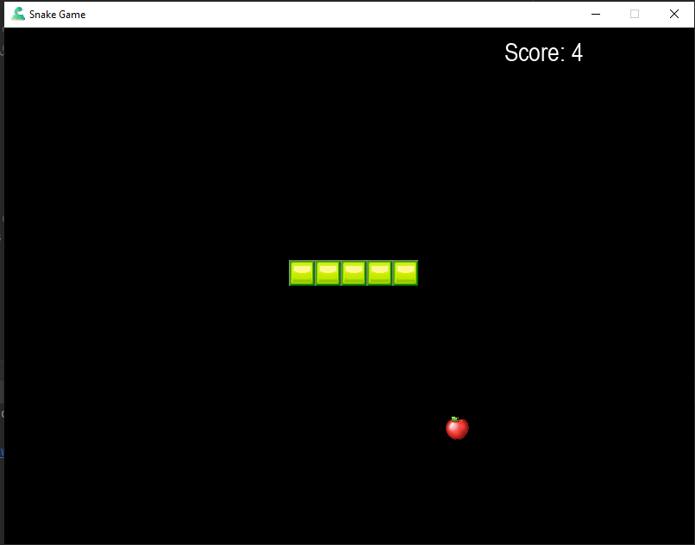
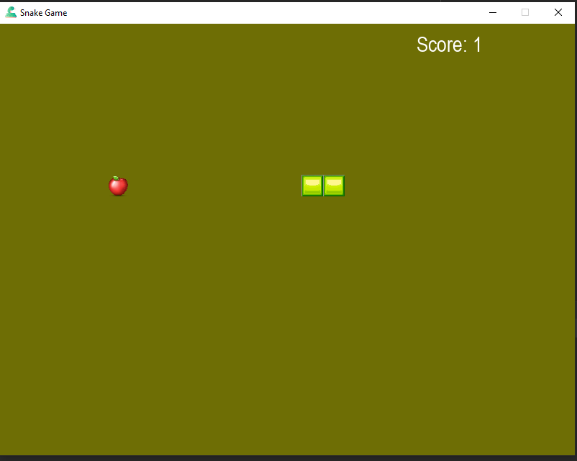
Trailing Components
Stakeholder | Feedback | reflection
Philip | The game works smoothly, and i really like how you provide clear instructions on the title screen and end screen. The only suggestions i have is that, you could change the background colour of the game window to black | I considered this suggestion by philip, but i personally thought that the background of the game window would look more aesthetic and eye pleasing if it was green.And the green colour also represents grass, as it makes more sense that the snake would move in grass. This correlates with the implication of aesthetics, as it looks more natural and eye pleasing. And green background also compliments the bright green colour of the snake.
Options

Slide 26
Trailing components
Stakeholder | Feedback | Reflection
Scott | The overall game runs smoothly, the only suggestion I could give you is to add some background music, This would make the game more engaging and entertaining. | I thought about the feedback given by scott, and decided to add background music. I made this change because, I felt adding music would make the game a lot more entertaining an appealing to end-users. I have also read an article which states that game developer’s use music to make games more entertaining.

Slide 27
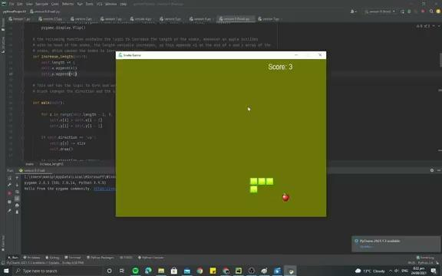
Trailing components
With music
Without music
As you can see, music clearly makes the project more interesting and aesthetic. It hooks the end-user, and make them want to play the game for a longer time.

Slide 28
Testing outcome
Record evidence that you have tested your outcome.
Explain how the testing made sure your outcome functions as intended to meet its purpose and requirements.
Record evidence that you have used information from testing appropriately to improve the functionality of the outcome.

Slide 29
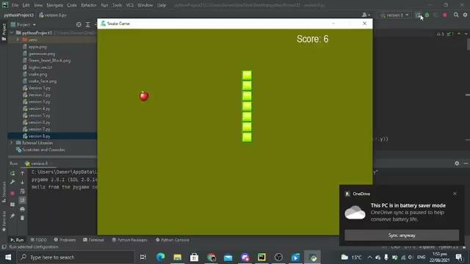
Debugging
Bug 1:

Slide 30
Debugging
Bug 1:
when the snake is over 5 blocks long and is moving in a certain direction, the bug will occur. This bug causes the game to end when the snake is asked to move in the opposite direction to its motion.
Solution:
I had to create a command to lock the direction of the snake. This means that the snake can only move in one direction, if its asked to move in the opposite direction it will keep moving in the direction which it was already moving.This suggests that the snake can only change its direction of motion perpendicularly. Like example, if it’s moving straight, i can only turn right or left.

Slide 31
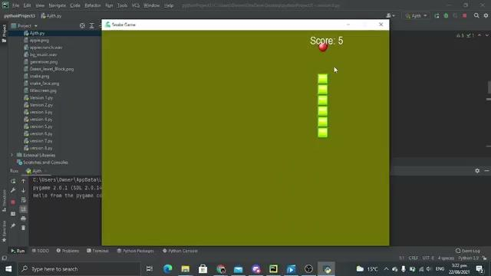
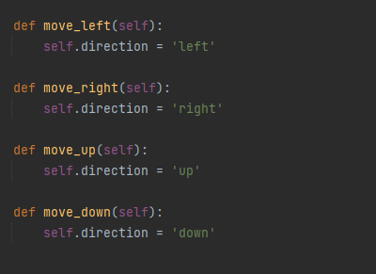
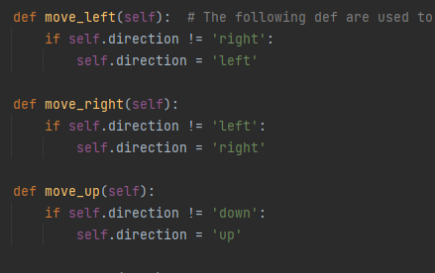
Debugging
Before
After

Slide 32
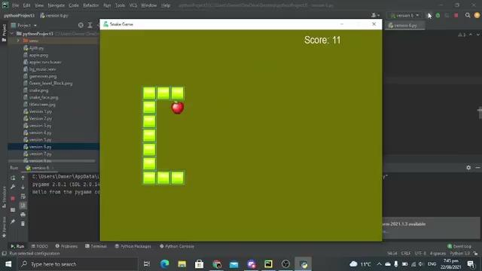
Debbuging
Bug 2

Slide 33
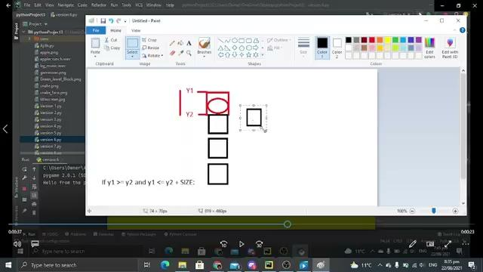
Debugging
Bug 2:
In some instances the snake is detecting a collision with the , without even coming in contact with the apple.
Solution:
The solution for this bug is complicated, as i need to go through the entire collision logic to fix this bug. So therefore i have created a video explaining the basics of the collision logic,Which goes over how to fix the bug.

Slide 34
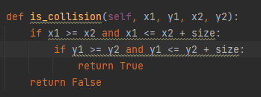
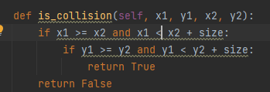

Debugging
Bug 2:
Before After
Bug fixed video

Slide 35
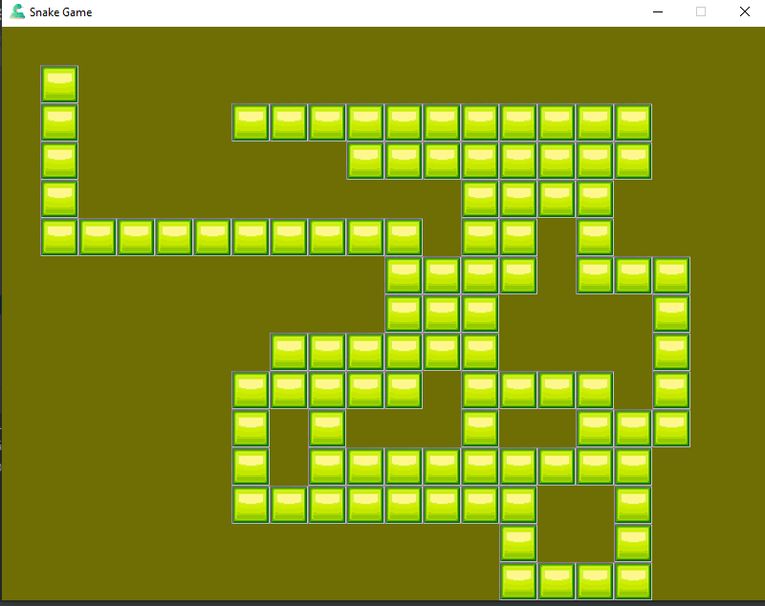
Debugging
Bug 3
As we can see the issue here is, the snake leaves a path behind it as it moves
Solution:
The solution to fix this bug is, i need to reset the screen every time the snake moves, so therefore it doesn't leave a trial.

Slide 36
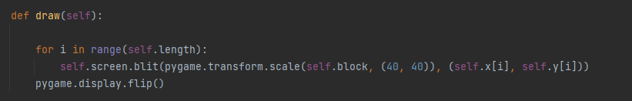
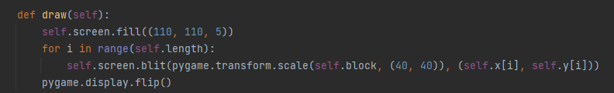
Debugging
Bug 3
Before:
After:

Slide 37
Debugging
Bug 3 (fixed)
As you can see the bug is fixed and the snake doesn't leave a trail anymore.

Slide 38
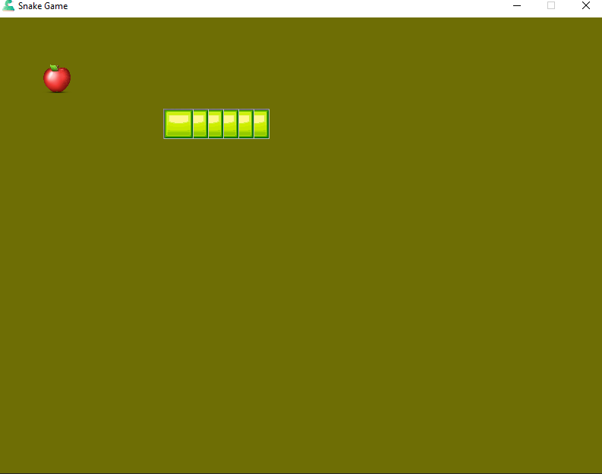
Debugging
Bug 4:
As you can see, it looks like the snake is colliding with itself.
Solution:
The solution to fix this bug is through making sure that the snake is incremented by the same size as the length of a block

Slide 39
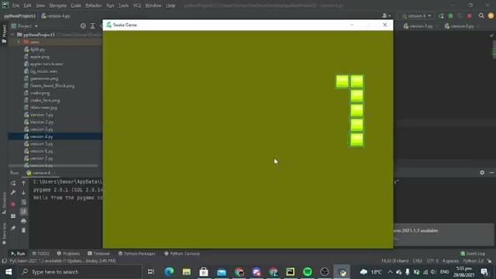
Debugging
Bug 4 (fixed)

Slide 40
Pep 8
My pep8 validation was perfect initially, but i got many errors after commenting the code. All of these errors state that “line too long”. This error means that a line in the code is too long. This error basically occurred because of commenting the code. The code was perfectly validated before adding comments, and i didnt realise that we had to validate the code again after commenting it, these lead to me getting a lower grade.This acted as an eye-opener for me and thought me a lesson that i should validate my code at all times. Before and after commenting it. I believe that if i actually commented my code in a proper manned i would’ve been able to achieve the higher grade that i deserve.

Slide 41
Testing table
Input tested | What should happen | What did happen | Fixes needed
Snake detects collision with the apple | Snake should increase length, and score should increase | Snake increases length and score increases. | Nothing needed
Snake detects collision with itself | Should exit game | Exits game | Nothing needed
Snake detects a collision with the wall | Should exit the game | Exists the game, but only detecting the after a part of the head goes across the boundary. | Need to change the boundaries at which the snake could travel.
Apples spawns in random locations | Apple should spawn in a random location after collision | Spawns in a random location, but sometimes it spawns out of screen. | Small fix needed to change the coordinates at which the apple can spawn.

Slide 42
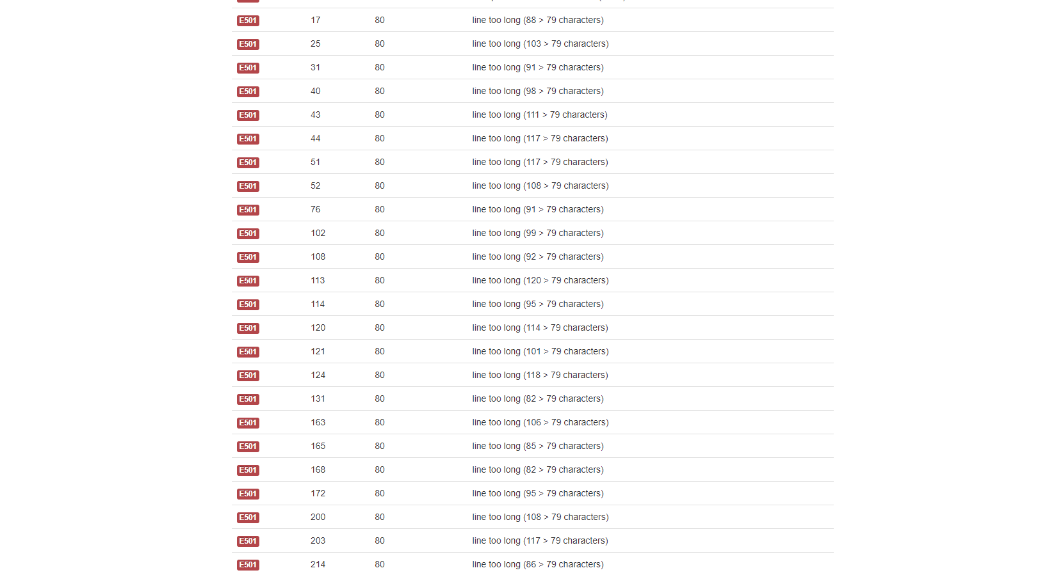
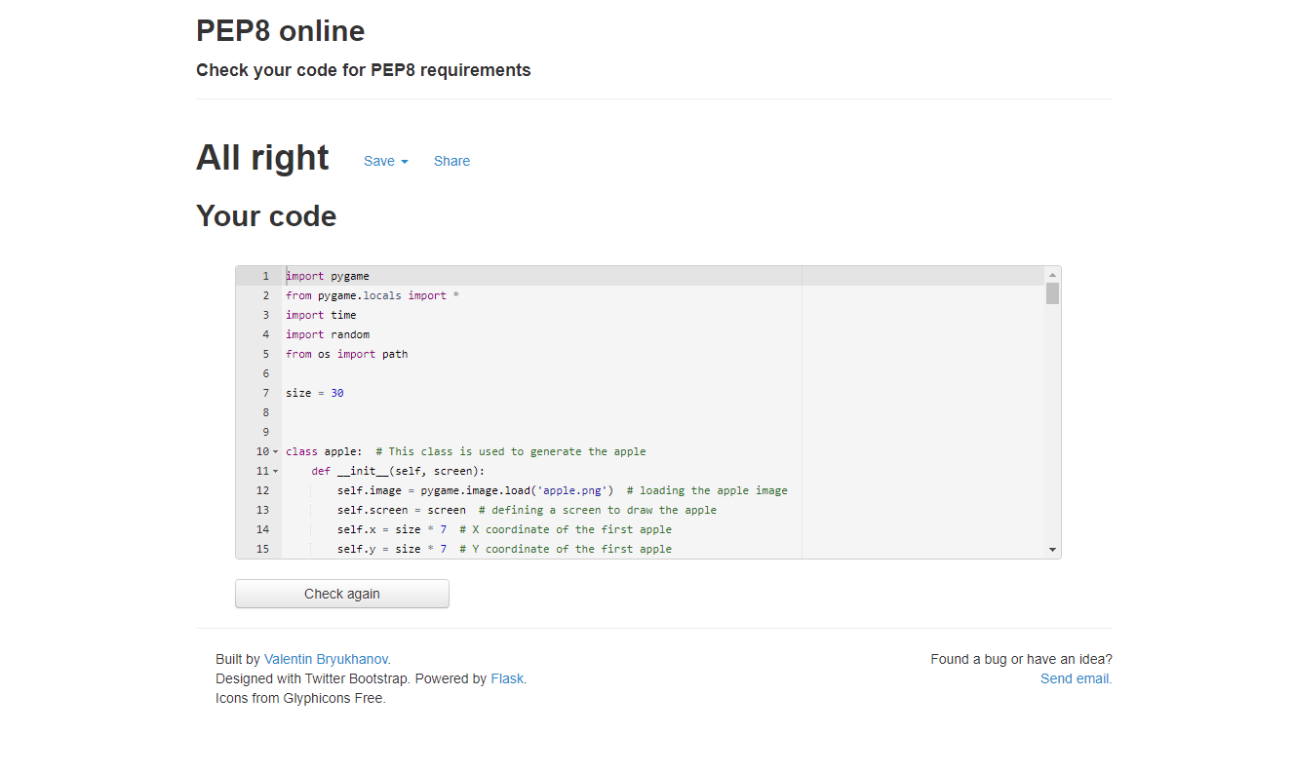
PEP8
After commenting
Before commenting
As you can see all the errors are caused due to comments.

Slide 43
Version Control
I chose to manage different versions of my code through saving them in a folder, in my computer. Whenever I had to make a major change to my code, I saved a copy of the previous version of the code in a folder. I chose not to use Github because it looked overwhelming when I first saw it, and i thought there was no point is spending time to actually learn how to use Github when I have a simpler way to store/record versions.

Slide 44
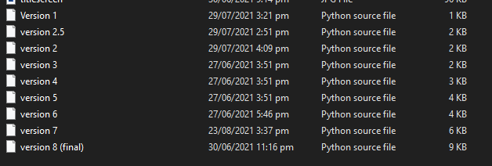
Version Control

Slide 45
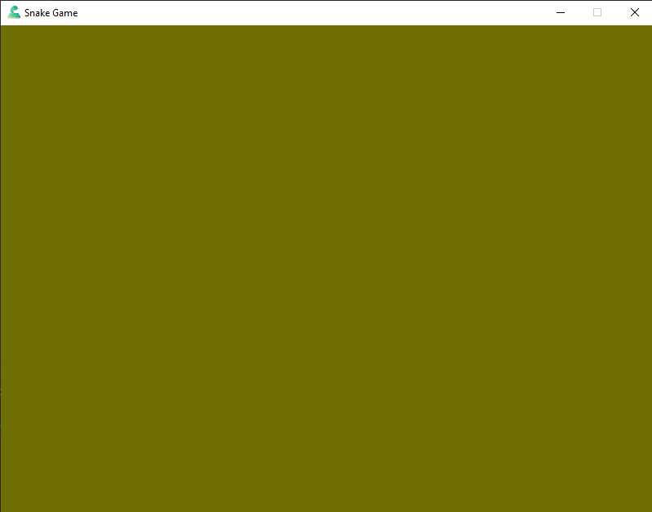
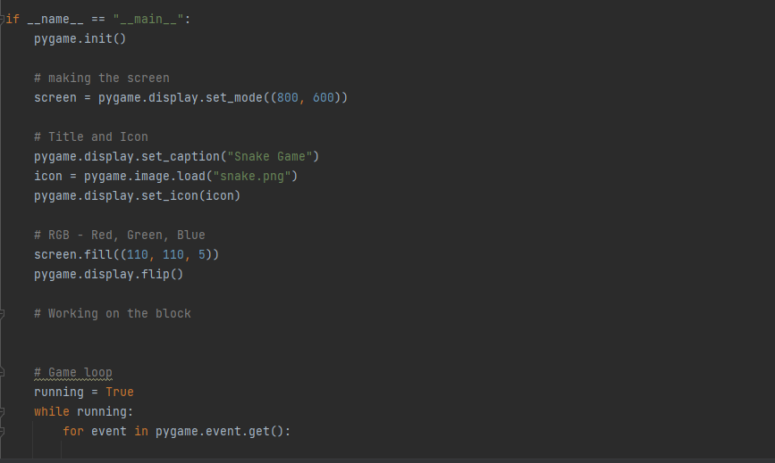
Version Control
Version1 - Version consists of a basic game window which has a colour,logo,and a name.
Game Window
Code

Slide 46
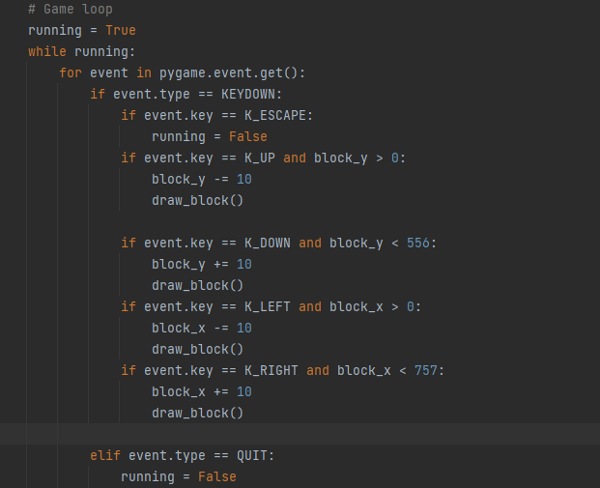
Version control
Version 2- In this version i created a block, which accepts keyboard commands and moves accordingly.
Game window
Code

Slide 47
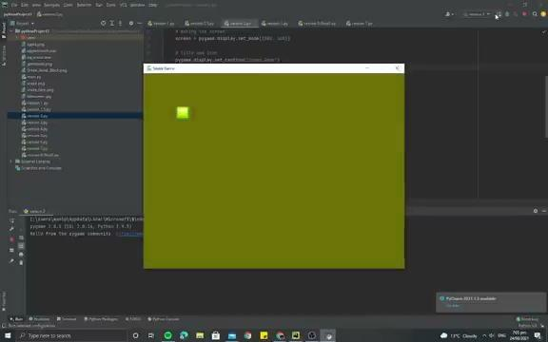
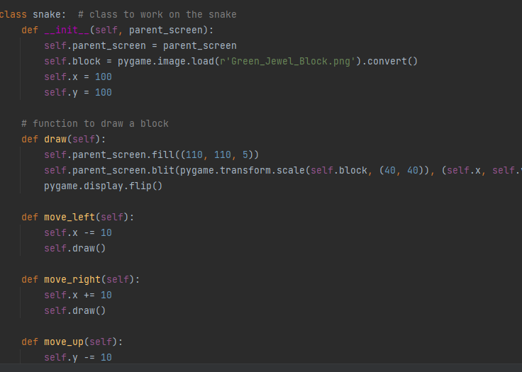
Version Control
Version 3- This version performs the same function as the previous version, but the structure of the code is changed to OOP(object oriented programming).
Game Window
Code

Slide 48
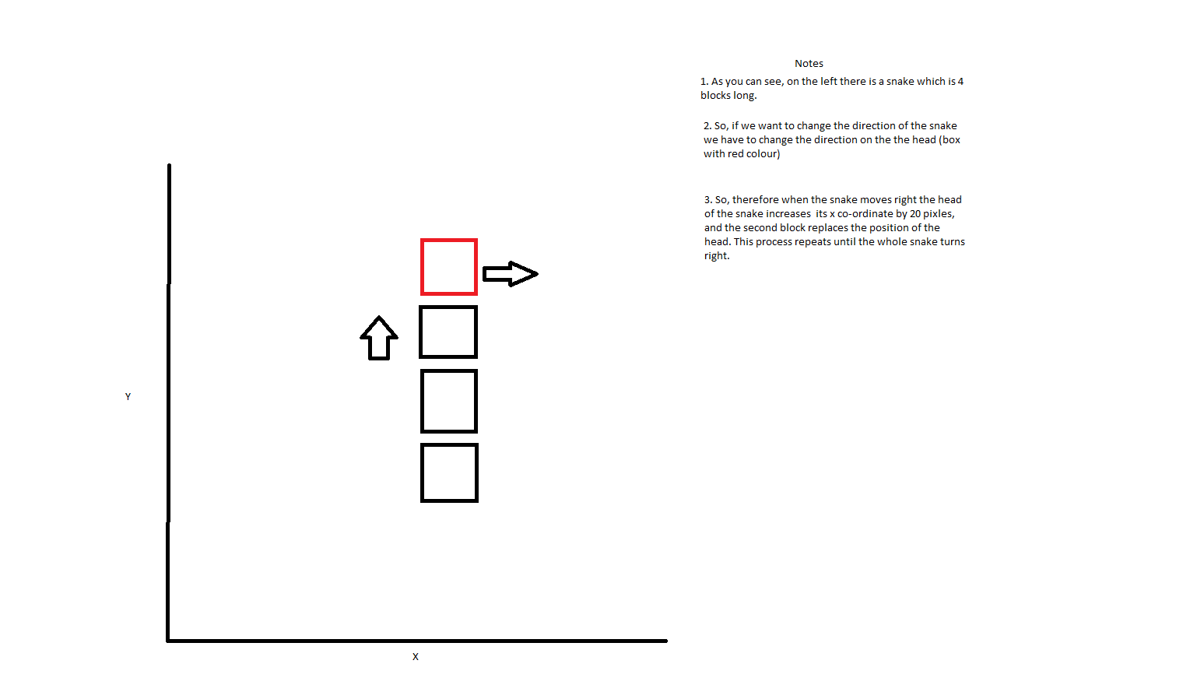
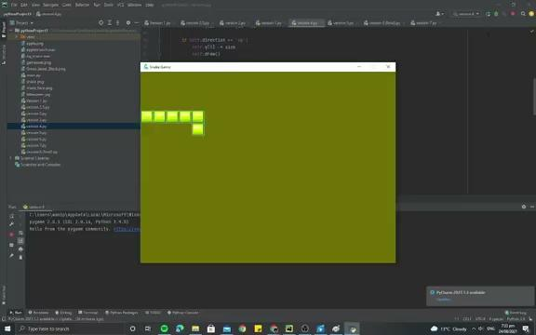
Version Control
Version 4- During this version, the snake moves automatically and changes direction when an arrow key is pressed. I would like to explain the logic of snakes movement through a diagram.
Drawing (movement logic)
Game window

Slide 49
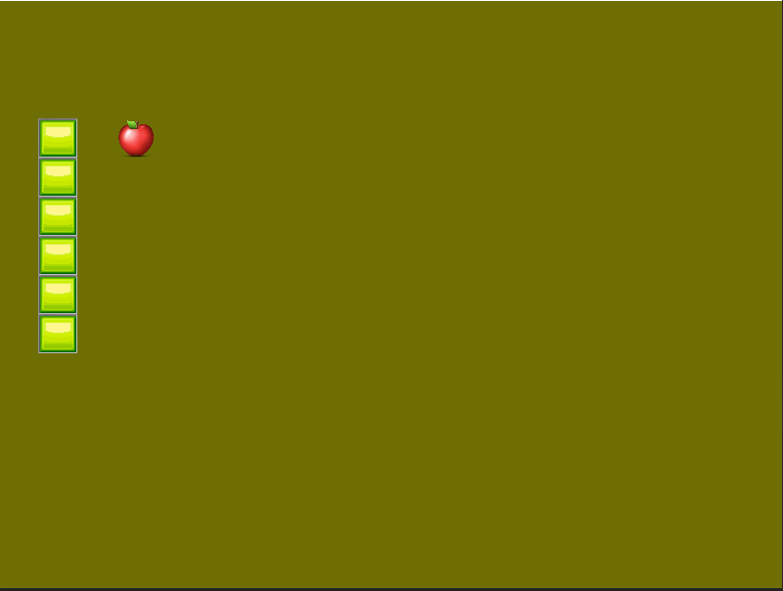
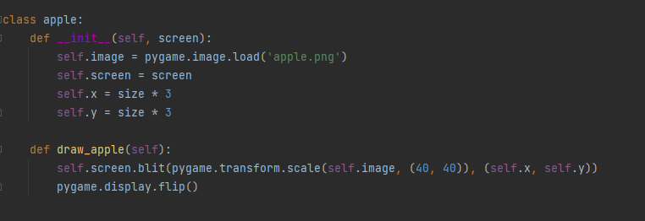
Version Control
Version 5- During this version an apple is added to the game. So, therefore an apple class was created.
Game Window
Code

Slide 50
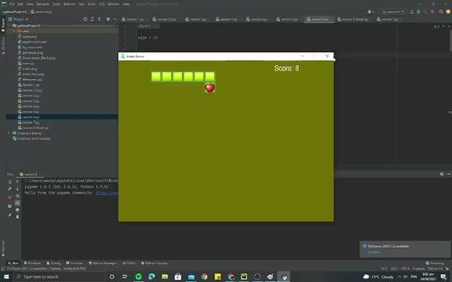
Version control
Version 6- During this version the collision logic is introduced, This logic basically detects a collision whenever the head of the snake comes in contact with something, like example apple or wall. Another feature added in this version is the incrementing of snake when it comes in contact with the apple.
This video briefly explains collision logic. ps.The snake detects collision when both the conditions are met.
Game window

Slide 51
Version control
Version 7- The added features in this version include, the snake colliding with itself and exiting to the end screen.
Game window

Slide 52
Version 8 (final version)
Version 8- This version includes addition of features such as background music and title screen and high score.

Slide 53
Usability testing
Stakeholder | Notes
Aidan | Its an enjoyable game 1 suggestion i could give you is to add a title screen which shows the controls. Because it’s kinda confusing if it just directly goes into the game, i was thinking it would be smoother if you add a title screen. I like the background music, it gives off a good vibe. Overall it’s a good game
Reflection:
After going through the notes that Aidan provided, it made me consider that probably adding a title screen makes my project more clear and interesting. This is because, If you just press run and the game starts,It doesn't really give the end-user information on how to play the game. I feel like this would give a negative first impression of the game. So, therefore decided to add a title screen, which gives the end-user information on how to control the snake. And I also gave the end-user and option to start the game at their convenience.

Slide 54
Evaluating against requirements
I wanted my end project to operate smoothly and without any issues or bugs.In Order to do this i have tested my project thoroughly after every week of work. Another thing i wanted to make sure is that my project is accessible for wide range of users, this includes people who don't usually play games. In Order to do this i have made sure to include instructions on how to play he game in the title screen, as not everyone has played the snake game before. Another requirement I wanted in this project is the ability to play again. I have coded the game in such a way that the end-user could simply press enter key while they are in the end screen in order to play again.

Slide 55
Evaluating against Implications
While I was coding the game, i always had a thought of implications in my mind. When i was making the game I always made sure to use copyright free images, this correlates with the implication of law. Another implication i focused about throughout the preparation of the project is Aesthetics. Throughout the project I always tried to make the game as aesthetically pleasing as possible, in order to do this I added custom made title screen and end screen. Another way i improved the aesthetics of the game is through adding background music, this keeps the audience engaged for a longer period of time. Sustainability and future proofing is another implication that i had in mind while coding the program. In order to justify this implication I used OOP structure, so that my project had more potential to upgrade in future.

Slide 56
Final testing

Slide 57
Legal
This implication states that my digital outcome should not contain any intellectual property that i don't have permission to use, and it should not contain any private information.
Throughout the project I made sure that I used copyright free images from websites such as Pixbay.com to avoid any copyright issues. Both the end screen and the title screen were made by using Photoshop, as our school provides us with a adobe suite at the beginning of the year. The software I used to write my code is Pycharm community edition, which is a free to use software.I plan to distribute my game digitally through applications such as Steam. I also made sure that I don't ask any private information from the end user. The music that's been playing in the background is copyright free music, i downloaded it from https://www.bensound.com/.

Slide 58
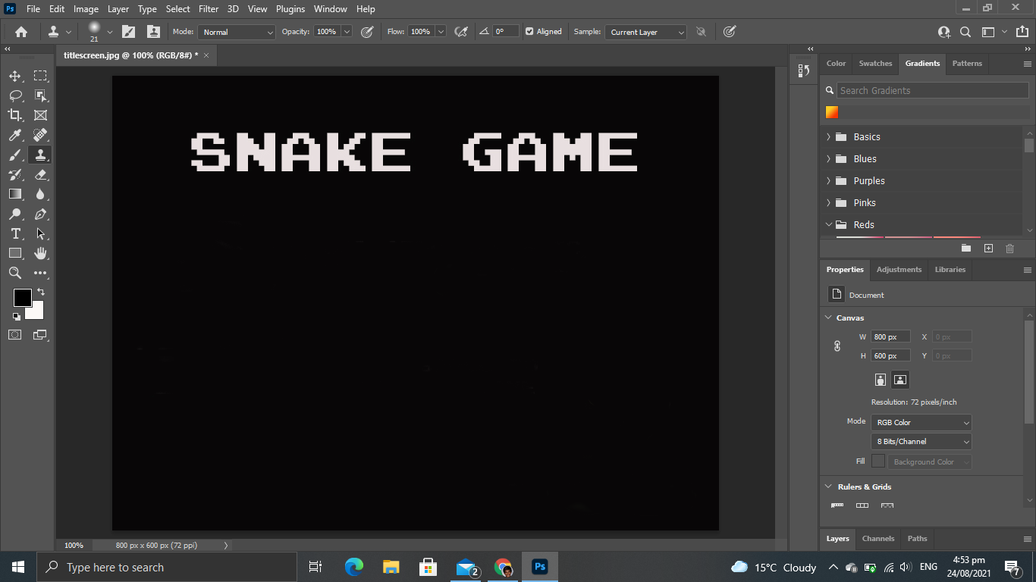
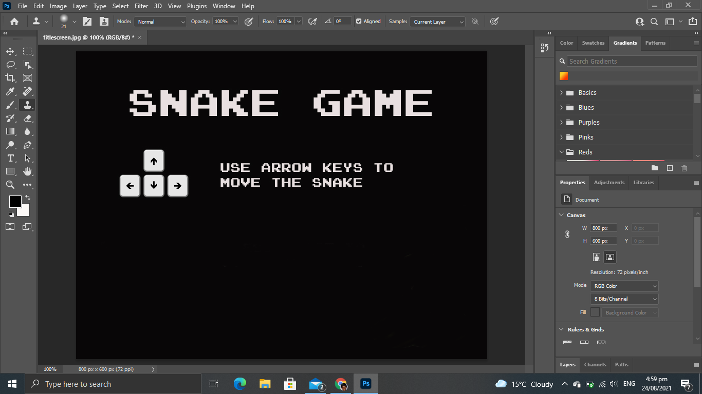
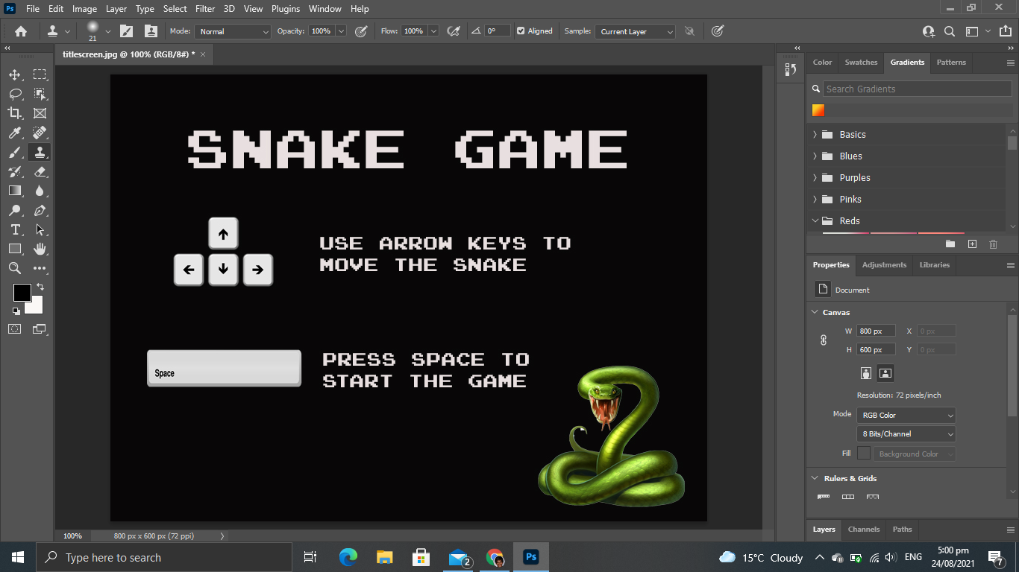
1.Legal (evidence)
Making of title screen using photoshop

Slide 59
2. Usability
This implication states that the developed digital outcome should be easy for the end user to operate.
This implication is relevant to my outcome (snake game) because without clear instructions on how to play the game, the end-user user would find it difficult to play the game. I made sure that the game is more usable for the end-user by adding instructions on how to move the snake on the title screen. I also made sure that there is a prompt displayed on the end screen which says “press enter to play again”, this gives clear instructions for the end-user if they desire to play again. I made sure that arrow keys are used to control the snake, because i thought that some of the end users that play my game might not have much knowledge in gaming. So therefore they would be confused if I used W,S,A,D to control the snake.

Slide 60
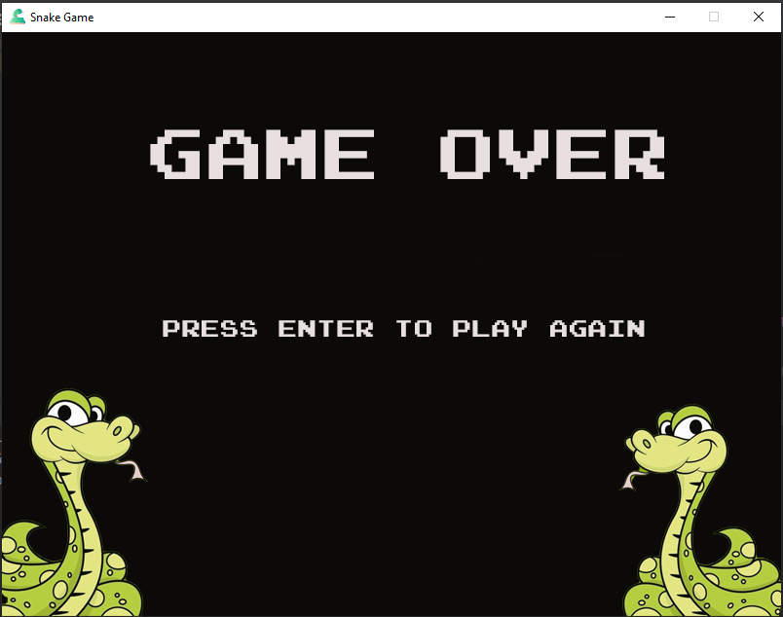
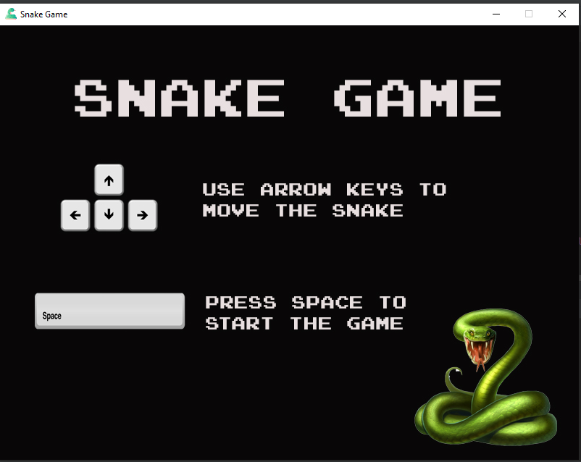
Usability (Evidence)
End Screen
Title screen

Slide 61
3. Sustainability and future proofing
This implication states that, The code should be arranged in such a way that changes and updates could be done easily.
This is relevant to my outcome (snake game) because a game usually tends to lose interest as time passes, this is the reason why there is a need for constant changes and updates to the game. I made sure that this could be done using object oriented programming to arrange my code. This gives me the ability to divide my code into smaller components called classes, these include snake class, apple class and a game class. This makes it easier to make changes because, if i want to make changes to the snake all i need to do is add a new function in the snake class.I believe that using OOP method to arrange my code increases the potential for the outcome to upgrade into a better version in future.

Slide 62
Sustainability and future proofing (Evidence)

Slide 63
4. Aesthetics
Aesthetics is all about about the look and feel of the digital outcome, this suggests that I have to be aware of what I could to to ensure that the project is appealing to the target audience.
Aesthetics is a relevant implication for my project because games are meant to be played frequently, if a game doesn't appeal to the audience they wouldn't play frequently. So, throughout the development I made sure that the game is visually appealing. One of ways I did this is through adding background music, although this doesn’t change anything visually, but it gives the audience a sense of relaxation and comfort, which leads for the end user to play the game for a longer time. Another feature I added to my project to increment the aesthetics is a, custom made title screen. I tried to make this as appealing as possible as this acts as an introduction to the game and it hooks the attention of end-user.

Slide 64
Aesthetics
With music
Without music
You can clearly see how music make the game a lot more engaging and enjoyable

Slide 65
Evaluate
Discuss how the information from planning, testing and trialling of components assisted in the development of a high-quality outcome.

Slide 66
Evaluation
I used trello board to plan my project, this really assisted me throughout the making of project as it actually distributed my workload over equal periods of time. Another benefit of using trello board to manage our project is that it sends me a report at the end of every week, this acts as a reminder for me to finish the work that i have set myself in the following week.As a result i didn't run out of time and submitted the project before the due date.
I trailed the project with one of my friend and he suggested that adding a Title screen would give clear instructions for the end user on how to play the game. I reflected on his feedback and added a title screen to my project, i believe that this would make my game accessible for a wider range of audience. Even though snake game is a fairly popular game, there might be certain people who had never played the game before. So, the title screen gives gives them clear instruction on how to play the game.

Slide 67
Evaluation
I made sure to test my project thoroughly at the end of each week for any bugs.while i was testing the spawning of apple i realised that sometimes the apple actually spawns outside the screen. I had to go back and make some changes to the boundaries, so that the apples always spawns inside the game window. This made my finished code more functionable and usable. This is just one of the many bugs that i have found while coding my project, I feel like bugs are just a part of the process and its always better to fix them as we go, rather then clearing them all at once. Testing my code on a regular basis helped me find and fix these bugs and errors, which therefore incremented the quality of my outcome.

Slide 68
Evaluation
Overall i would say that the outcome turned out to be how I envisioned it to be, but if i had a chance to change anything i would’ve added a leaderboard. I believe that adding a leader board will make the end-user feel competitive and play the game more often. But i am still happy with the way the project turned out to be.
I believe that i could’ve done a better job by verifying my code through PEP8 checker more often. This would’ve given me a Higher grade. And i also think that I could’ve structured my code better so that its more clear.

